Slide 1
Hints and Tricks Density Lab
World Campus Chemistry 101

Slide 2

Measuring Density by Water Displacement
Volume is the amount of space an object occupies
For an irregularly shaped object, like a screw, paperclip, key, etc. it is difficult to measure volume compared to a cube or sphere.
Putting the object in a known volume of liquid and measuring the change will give you the volume of your object of interest
You can then use the mass of the object and your calculated volume to find density.
Place object into known volume of water
(Volume of liquid AND object) – (Volume of liquid alone) = (Volume of object)

Slide 3
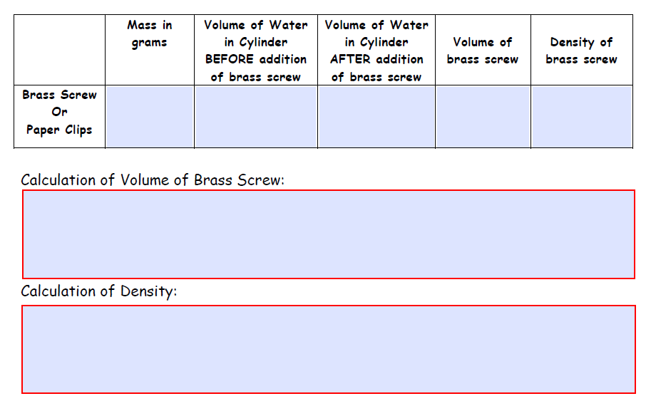
Here’s what your lab report sheet looks like:
You’ll need to fill out all of the boxes with either measurements or calculations.
I’ve noted whether each box will come from something that you will MEASURE or something you will CALCULATE from your measurements.
My notes to help you are in RED
measure
calculate
See below
calculate
See below
measure
measure
(Volume of water AND object) – (Volume of water ALONE) = (Volume of Object)
Density = (Mass of object)/(volume of object)

Slide 4
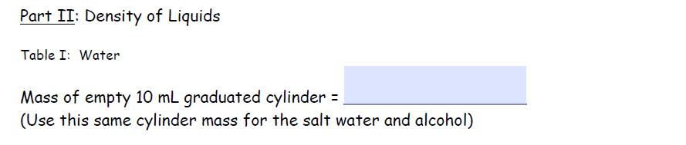
Density of Liquids
Throughout the rest of the lab you will be measuring the mass of your liquid IN your graduated cylinder. The masses you measure will be the SUM of the masses of the graduated cylinder AND your liquid of interest.
You will want to measure the mass of your DRY graduated cylinder and record it right away! That way you can easily find the value and use it for calculations as needed.
Here’s what your lab report looks like:
Make sure you measure and record the mass of your graduated cylinder right away!
measure

Slide 5
Calculating the density of liquids
The volume of the liquid can be measured with the graduated cylinder. Record the volume in your table.
Measure the mass of the liquid in your graduated cylinder and record the value in your table.
Repeat as necessary for other volumes of liquid and/or other types of liquid.
Before you calculate density, you will need to calculate the mass of the liquid alone. This can be found by subtracting the mass of your graduated cylinder from the mass of the water and graduated cylinder together.
(mass of water AND graduated cylinder) – (mass of graduated cylinder) = (mass of water alone)

Slide 6
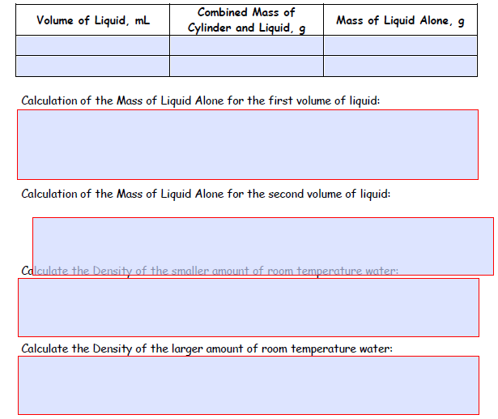
1st volume of water
measure
measure
Calculate, See below
2nd volume of water
measure
measure
Calculate, See below
(mass of water AND graduated cylinder) – (mass of graduated cylinder) = (mass of water alone)
(mass of water AND graduated cylinder) – (mass of graduated cylinder) = (mass of water alone)
Density = (mass of 1st water sample)/(volume of 1st water sample
Density = (mass of 2nd water sample)/(volume of 2nd water sample

Slide 7
The calculations for the other liquids is done in the same way as was done for water.
Measure and record volume of liquid
Measure and record mass of liquid in graduated cylinder
Calculate mass of liquid alone by subtracting mass of graduated cylinder from mass recorded above
Calculate density of liquid by dividing mass of liquid alone by the volume of the liquid.
Good luck and don’t hesitate to contact your TA with questions!

